Slide 1
TRUE STORY
For three months,
I couldn't start anything.
A dozen ideas. Nothing shipped.
Notes:
[Walk on. Don't introduce yourself. Let the room settle for exactly one second. Then:]
'I want to tell you a true story.'
[Beat. Let them read the slide.]
'Three months. A dozen ideas. I couldn't ship a single one.'
[Click immediately.]

Slide 2
THEN
I started taking interviews.
Everyone had perfect recall.
afterwards.
I lost rooms I should have owned.
Notes:
'So I did what any founder does when they're stuck. I went and talked to people.'
[Beat.]
'I took interviews. A lot of them.'
[Beat. Slower now.]
'And I kept noticing the same thing. Everyone on the other side of the table had perfect recall — of what they should have said. Afterwards.'
[Pause. Drop your voice.]
'I lost rooms I should have owned.'
[Click immediately.]

Slide 3
THEN IT HIT ME
Every interview
is a sales call.
And nobody had a tool in the room.
Notes:
'And then it hit me.'
[Beat.]
'Every interview is a sales call. You're selling yourself. They're selling the role. It's two people performing under pressure, and both of them are going in blind.'
[Beat.]
'Nobody had a tool in the room.'
[Click. Now breathe. Slow all the way down.]

Slide 4

sussur
A whisper, when it matters.
From Latin susurrus. The word sounds like what it means.
The tool for the speaker. Not the listener.
Notes:
'So I built one.'
[Long beat. Let them read the name.]
'Sussur. Latin — susurrus.'
[Pause.]
'Say it out loud and you hear what it means.'
[Beat. Sharper.]
'The tool for the speaker. Not the listener.'
[Click.]

Slide 5
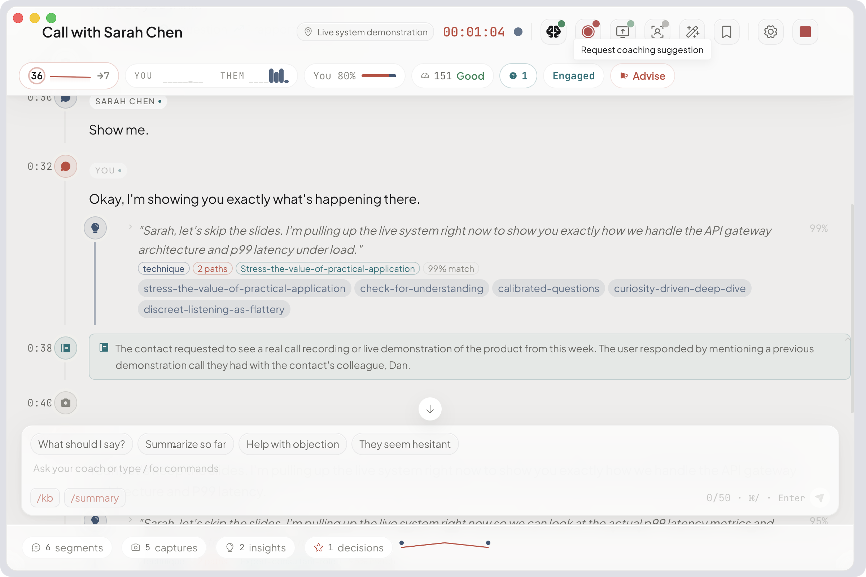
WHAT IT DOES
I built the app
that listens to the call,
and coaches the rep
in real time.
So they close more deals.
ON-DEVICE · AUDIO NEVER LEAVES THE MAC · BRING YOUR OWN LLM KEY
Notes:
[The slide says what it does. You say who it's for and why it matters.]
'A sales rep opens a call. The app listens. When a pricing objection lands, she gets a prompt — before she discounts. When the prospect goes cold, she gets the reframe — before she loses the room.'
[Beat.]
'On her Mac. Audio never touches a server. She brings her own LLM key — no data on our side. No procurement blocker.'
[Beat. Drop your voice.]
'So they close more deals.'
[Click.]

Slide 6
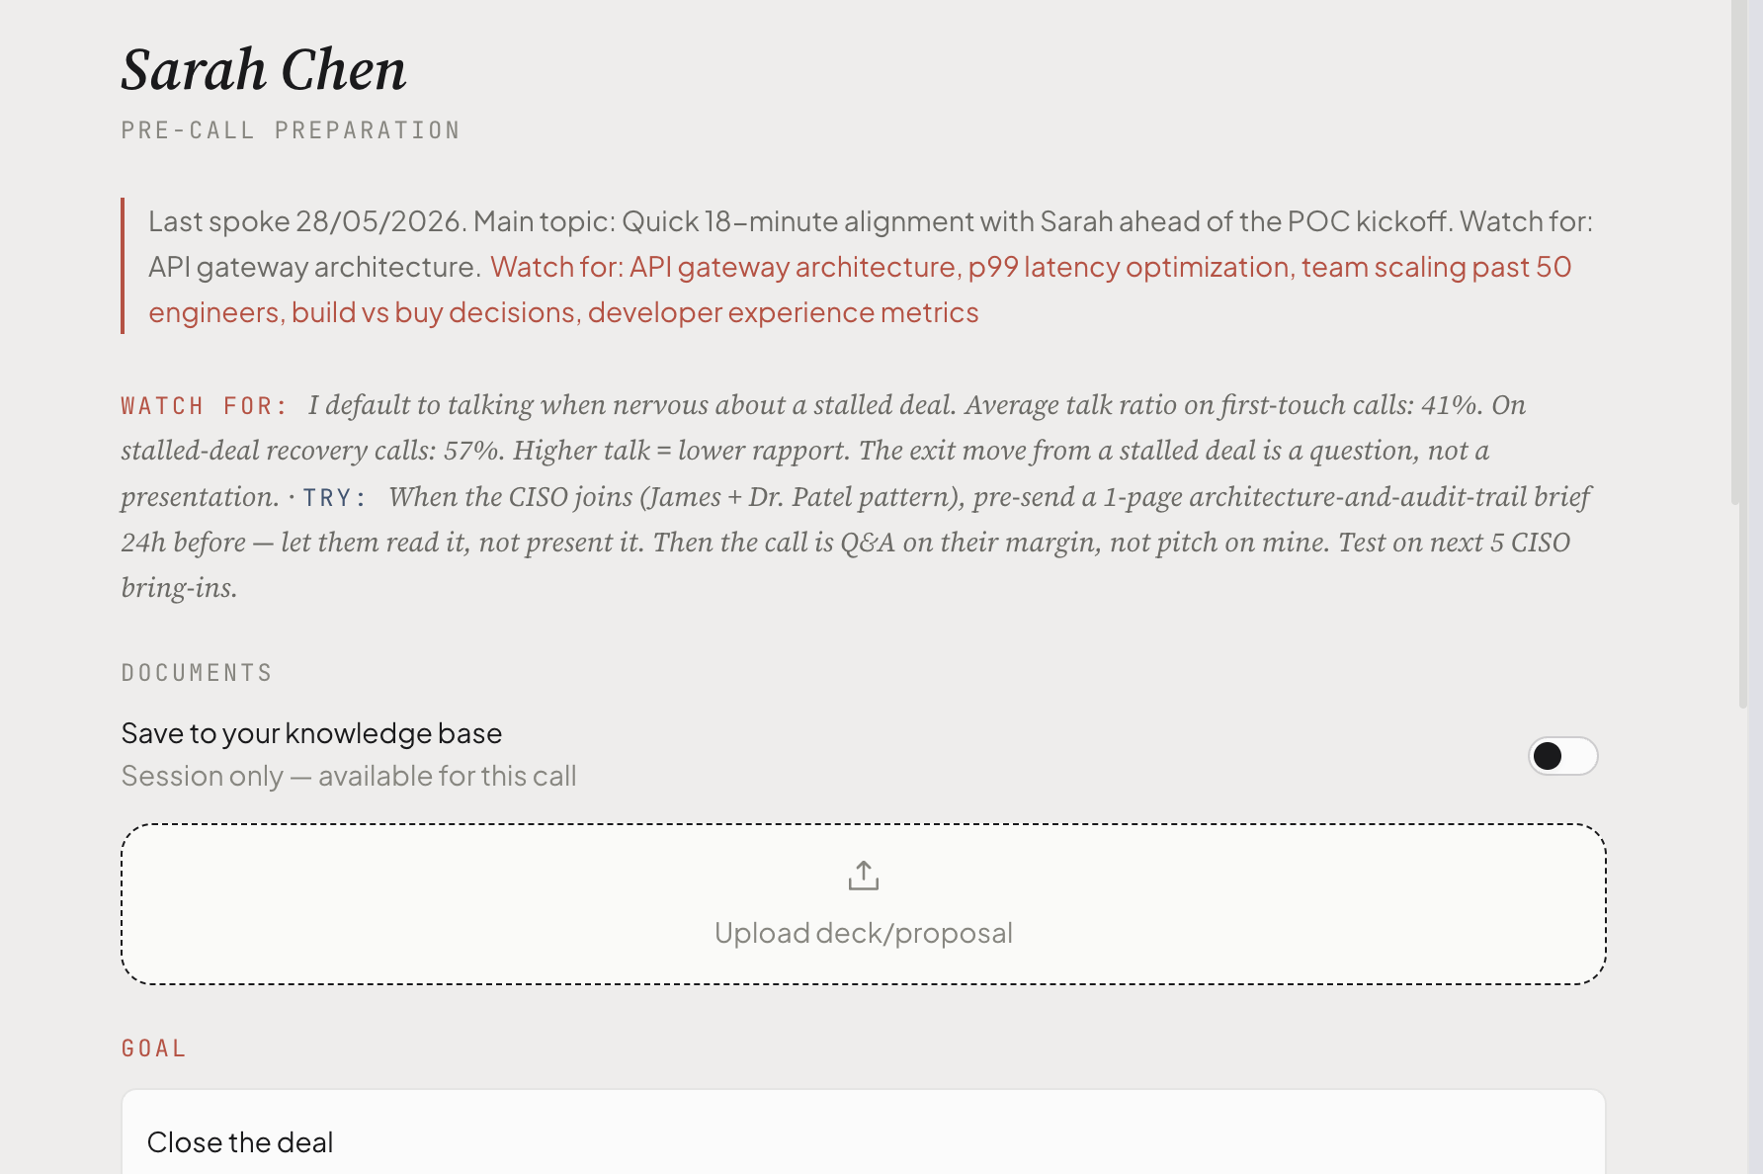
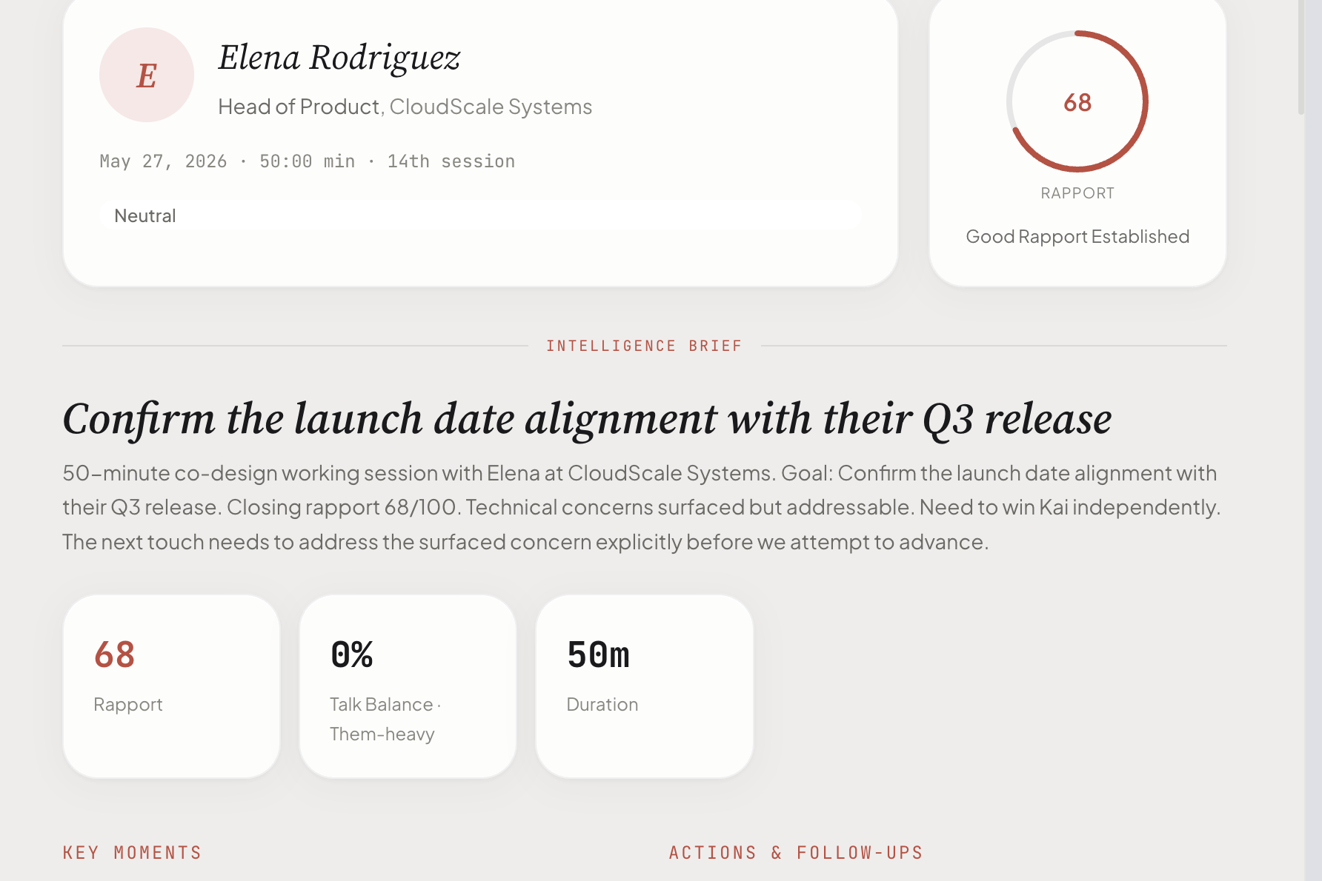
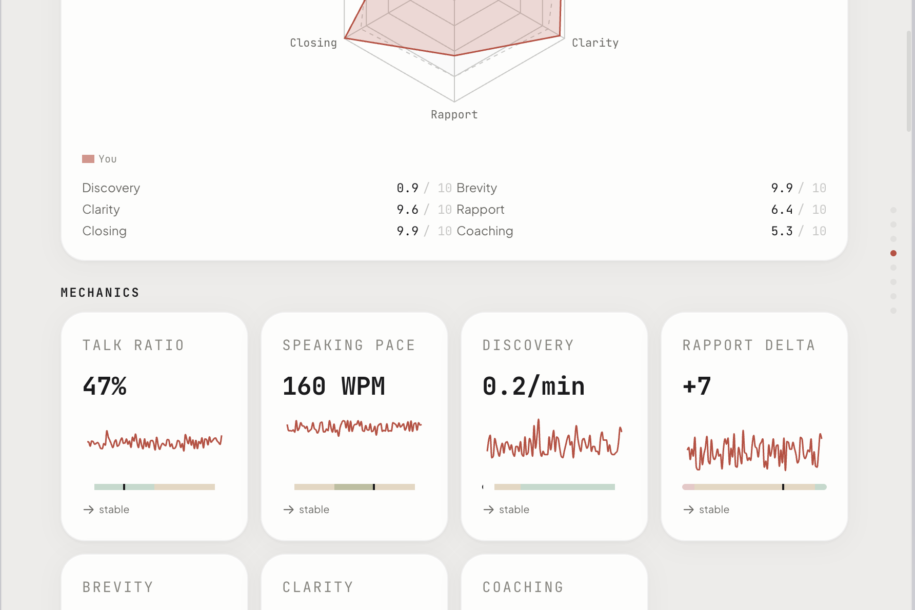
WHAT IT LOOKS LIKE
Before. After. Over time.
BEFORE THE CALL
AFTER THE CALL
OVER TIME
AI-prepared brief in 30 seconds.
Key moments. Techniques cited.
Monthly coaching narrative.
Mac app. On-device. 89 organic waitlist signups.
Notes:
[Three screenshots on screen. Point at each one as you speak. Almost no words.]
'Three screens.'
[Point left — Onboarding.]
'She picks her use case. Thirty seconds. Done.'
[Point center — Home.]
'Her briefing is ready. Her session is one click away.'
[Point right — Pre-Call Prep.]
'Before the call — game plan, contact context, the documents she needs.'
[Beat. Look up.]
'This exists. It ships today. Eighty-nine people on the waitlist. Zero paid spend to get them there.'
[Click.]

Slide 7








THE COMPETITION
Only one in this quadrant.
Architecture × buyer. The two axes nobody else gets right.
↑ INDIVIDUAL
NOTETAKERS / SCRIBES
THE WHISPER LAYER
Otter
Granola
sussur
Cluely
tldv
RT ✓
OD ✗
IND ✓
SAL ⚠
2+1 / 4
RT ✓
OD ✓
IND ✓
SAL ✓
4 / 4 · ONLY US
ENTERPRISE FLOOR
OPEN · NEXT PLAY
Gong
Clari Copilot
—
Chorus
MS Copilot
0 of 9 competitors here
B2B + on-device · the next play
↓ ENTERPRISE
RT ✓
OD ✗
IND ✗
SAL ✓
2 / 4
← CLOUD + BOT
ON-DEVICE + NATIVE →
Real-time · On-device · Individual buyer · Sales-specific. Only us.
Notes:
'Two axes.'
[Trace horizontal with your hand.]
'Left to right: cloud and bot, to on-device.'
[Trace vertical.]
'Bottom to top: enterprise, to individual.'
[Point bottom-left.]
'Gong, Clari, Chorus, Copilot. Two out of four. CIO signature, six-month procurement.'
[Point top-left.]
'Otter, Granola, Cluely, tldv. Individual buyers — but audio to the cloud. Bot in the room.'
[Point top-right. Slow. Smile.]
'Top right. Individual AND on-device. Zero of nine competitors are here.'
[Pause.]
'We are. Four out of four. Only us.'
[Click.]

Slide 8
HOW WE MAKE MONEY
Two SKUs. >90% margin. Sold direct.
PERSONAL · THE REP
BUSINESS · THE TEAM
€49 / €99 / €149
€30 / €60 / €120 / mo
ONE-TIME · BRING YOUR OWN LLM KEY
20% OFF ANNUAL · MANAGED LLM
·
Sold on her own credit card before procurement
·
Compounds from month six as reps convert their teams
·
Zero variable cost. The user owns the LLM relationship
·
$0.0025 per coached minute · ~95% gross margin
·
€49 founding tier locks the first 500 evangelists
·
Same Mac app. Same code. Different motion.
Notes:
'Same app. Same code. Two buying motions.'
[Point left card.]
'Personal. Forty-nine to one-forty-nine, one time. She buys it before procurement gets called. Zero variable cost — she owns the LLM key.'
[Point right card.]
'Business. Thirty to a hundred-twenty per seat per month. Managed LLM. Ninety-five percent gross margin.'
[Beat.]
'Personal is how we get in the building. Business is how we stay.'
[Click.]

Slide 9
GO TO MARKET
Five channels. Pre-revenue. Honest data by month six.
01
02
03
04
05
Direct via my network
PLG referral loops
Setapp + Mac discovery
Product Hunt launch
Google + LinkedIn paid
Build in public. Weekly product updates. Convert attention into meetings.
Measure every click. Self-serve referrals. Learn from the first users.
Setapp, MacUpdate, App Store. Passive recurring reach.
Month-three spike. Free. Positions the category for 12 months.
High-intent search. LinkedIn for high-value sales teams. CAC is high. Deals justify it.
PRE-REVENUE · NO CAC YET · NO LTV YET · THAT'S WHAT THE ROUND BUYS
Notes:
'Five channels. I don't know yet which one wins.'
[Quick beats. One sentence per card. Don't dwell.]
'One — my network. I build in public. That's where the eighty-nine came from.'
'Two — PLG. Every user pulls in a teammate.'
'Three — Setapp. Passive reach via Mac discovery.'
'Four — Product Hunt. Month three. Free spike.'
'Five — Google and LinkedIn. CAC is high. Deal size justifies it.'
[Look up. Honest.]
'No validated CAC. No LTV. That's what this round buys.'
[Click.]

Slide 10
MARKET
Europe runs on sales calls.
TAM
SAM
SOM
1.6M
320K
15K
European companies where sales
is the engine. Digitally ready.
SMB + mid-market sales teams
in our reachable regions.
Paid seats by year 3.
Broken down on the next slide.
Conversation intelligence is a multi-billion € category growing 12-25% per year. Europe is ~25% of global spend.
Eurostat 2024 · CEDEFOP 2022 · TBRC + Polaris CI market reports 2026
Notes:
'The category is multi-billion euros, growing twelve to twenty-five percent a year. Europe is a quarter of it. Unserved at the individual, on-device layer.'
[Glance at TAM.]
'One-point-six million European companies where sales is the engine. TAM.'
[Glance at SAM.]
'Three-twenty thousand Mac-friendly SMBs. Reachable. SAM.'
[Glance at SOM.]
'Fifteen thousand paid seats by year three. SOM.'
[Click.]

Slide 11
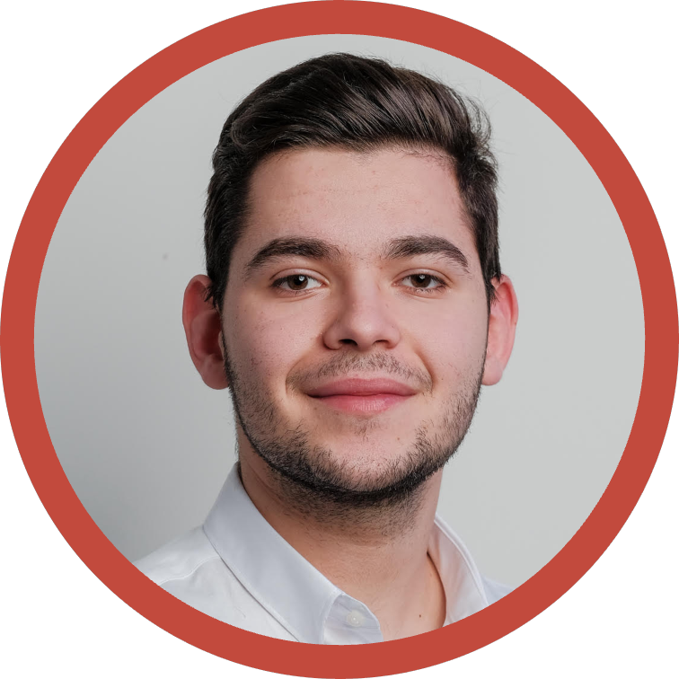
WHY ME
Solo. On purpose.
2 YC interviews
Avo S21. Basetool W22. One product still running today. And profitable.
CS at Twente · Best Thesis · IEEE
University of Twente (Netherlands). The Best Thesis became a published IEEE conference paper on neural language models, 2020.
Ironman finisher
MIHAI DAVID MARIN
Same discipline applied to product. When I commit, I close.
Founder & sole engineer
The 2026 thesis
Constanța, Romania
You don't need a team of six. A solo founder with AI tools can ship a serious product.
Notes:
'People ask why I'm doing this solo. It's not by accident.'
[Beat. Look the room in the eye.]
'Two YC interviews. Avo, Basetool. One is still running. Profitable.'
[Beat.]
'Computer Science at Twente. Best Thesis. IEEE paper on neural language models in twenty-twenty. Production ML before LLMs were a category.'
[Beat.]
'Ironman finisher. When I commit, I close.'
[Pause. Slow way down. This is the thesis line — land it.]
'In twenty-twenty-six, you don't need a team of six. A solo founder with the right AI tools ships a serious product. I'm proving it.'
[Click.]

Slide 12
THE ASK
€100K to €200K
SAFE · angel note
This is just growth money.
The product is built.
Notes:
[Let the number on screen land before you speak. Count two seconds.]
'One hundred to two hundred thousand euros.'
[Beat. Silence. Don't fill it.]
'SAFE. Angel note.'
[Pause. Look up.]
'The product is built. This is not build money. This is not runway money.'
[Drop your voice.]
'This is just growth money.'
[Click.]

Slide 13

USE OF FUNDS + ROUND 2
WHERE THE MONEY GOES
FIND ME AT ROUND 2
60%
The whisper
actually whispers.
GTM
Google + LinkedIn paid. Founder content. Product Hunt. Setapp.
20%
Product
Eval credits. Design. Research. Mac-app surface that scales.
10%
Legal
Delaware C-Corp flip. SAFE paperwork. GDPR + DPA.
10%
Tooling
sussur.ai
LLM credits. Observability. Analytics. The boring monthlies.
david@basetool.ai
A whisper, when it matters.
Notes:
'Sixty percent goes to acquisition. Google, LinkedIn, founder content, Product Hunt, Setapp.'
'Twenty percent product. Ten legal — Delaware flip, SAFE paperwork, GDPR. Ten tooling.'
[Slow way down. Shift to the right panel.]
'Round 2 is where I actually show you the demo.'
[Beat.]
'The whisper actually whispers.'
[Beat. Smile.]
'Scan the QR. See you there.'
[Don't move. Don't click. Wait. The silence closes the room.]

Slide 14
APPENDIX · THE MOAT
Not an AI wrapper.
Three things you can't fake.
01
02
03
ML, not prompts
Curated knowledge base
Real on-device pipeline
IEEE conference paper, 2020 (neural language models).
Best Thesis, Computer Science, University of Twente.
Production ML before LLMs were a category.
Prompt engineering done right: versioned registry,
promptfoo evals on every change. Not vibe-coded.
Voss tactical empathy + Cialdini influence frameworks.
Each tactic tested, grounded, cited.
12 versioned LLM prompts in a registry.
8 promptfoo eval suites run on every prompt change.
sherpa-onnx + NVIDIA Parakeet TDT (on-device STT).
Multi-LLM orchestration via OpenRouter.
365 test files in CI.
Three months of integration, hand-tuned per language.
Forking is open. Reproducing the production system takes 12+ months.
Notes:
[APPENDIX. Removed from main pitch — held for bar Q&A.]
[25 seconds. The defensibility slide. Slow on the headline.]
'The moat. Not an AI wrapper. Three things you can't fake.'
[Point at 01.] 'Real machine learning. I published an IEEE conference paper in twenty twenty on neural language models. Best Thesis at Twente. Production ML before LLMs were a category. The six-signal rapport algorithm uses real signal-design and EMA smoothing. The prompts are engineered with a versioned registry and promptfoo evals running on every change. Not vibe-coded.'
[Point at 02.] 'A real knowledge base. Voss tactical empathy. Cialdini influence. Each tactic tested and grounded with citations. Twelve versioned prompts in a registry. Eight evaluation suites running on every prompt change.'
[Point at 03.] 'A real on-device pipeline. Sherpa-onnx plus NVIDIA Parakeet for the speech-to-text. Multi-LLM orchestration. Three hundred sixty-five test files in CI. Three months of integration work, hand-tuned per language.'
[Pause.] 'Forking is open. Reproducing the production system takes twelve plus months.'
Click.

Slide 15
APPENDIX · MY EXECUTION PLAYBOOK
Land. Scale. Expand.
01
Months 1-3
02
Months 3-9
03
Months 6-18
LAND
SCALE
EXPAND
First 100
100 → 500
Personal → Team
Convert existing assets.
Mac discovery + paid acquisition.
Evangelists pull their teams in.
89 organic waitlist signups
Founder-led content in public
Product Hunt launch month 3
Setapp (passive recurring)
Google high-intent keywords
LinkedIn paid for sales teams
In-app referral loops
Warm outbound from users
14-day team trial, no card
Founder content. Zero paid CAC.
Validated CAC target < €25.
First 5-10 business teams. €10-25K MRR.
Founder-led until product-led. Default-alive at month 12.
Notes:
[APPENDIX. Removed from main pitch — held for bar Q&A.]
[25 seconds. The execution playbook. Slow on the headline.]
'My execution playbook. Land. Scale. Expand.'
[Point at LAND.] 'Land: months one to three. I convert what I already have. Eighty-nine waitlist signups, LinkedIn three thousand, X around a thousand. Product Hunt launch in month three. First hundred paid licenses. Zero paid CAC.'
[Point at SCALE.] 'Scale: months three to nine. Setapp passive recurring. Google high-intent keywords like Gong alternative. LinkedIn paid for sales teams. Compound from a hundred to five hundred. Target CAC under twenty-five euros.'
[Point at EXPAND.] 'Expand: months six to eighteen. In-app referral loops. The personal user brings sussur to her team. First five to ten business teams. Ten to twenty-five K MRR business tier.'
[Pause. Look up.] 'Founder-led until product-led. Default-alive at month twelve.'
Click.

Slide 16
APPENDIX · WHO THIS IS FOR
Thirteen million sales workers.
Just in Europe.
CEDEFOP, 2022 · 7% of all EU employment
On commission.
To one person.
Mortgage on ten minutes.
A slice of their income
rides on the next call.
On one call.
With one shot.
The conversation tonight
pays the rent next month.
Every tool built for them is a record. A transcript. A scorecard for after.
None of them are in the room.
Notes:
[APPENDIX. Removed from main pitch — held for bar Q&A.]
[25 seconds]
'Thirteen million sales workers in Europe. CEDEFOP. Seven percent of every job on the continent.'
'On commission. To one person. On one call. With one shot. The mortgage depends on the next ten minutes.'
'Every tool built for them is a record. A scorecard for after. None of them are in the room.'
Click.

Slide 17
APPENDIX · THE WEDGE
There's a category for the listener.
There's nothing for the speaker.
FOR THE LISTENER
FOR THE SPEAKER
Otter Business
sussur.
$30 / seat / month · $19.99 annual
Sales Notetaker is locked behind Enterprise. Quote only.
€49 one-time
Gong
No platform fee.
$5K-$50K platform fee + $1,300-$3,000 / seat / year
No minimums.
$7,500-$65,000 onboarding before you ship.
No onboarding.
SUBSCRIPTION · PLATFORM FEES · ONBOARDING
ON-DEVICE · BYO LLM KEY · AUDIO NEVER LEAVES THE MAC
Notes:
[APPENDIX. Removed from main pitch — held for bar Q&A.]
[30 seconds. THE quotable slide. Slow. Surface the real numbers.]
'There's a category for the listener.'
[Point left.] 'Otter Business is thirty dollars a seat, monthly. Twenty annual. And here's the catch: Sales Notetaker, their sales-coaching feature, is locked behind Enterprise. Quote only.'
'Gong is the enterprise floor. Five thousand to fifty thousand platform fee. Thirteen hundred to three thousand per seat per year. Plus seven to sixty-five thousand onboarding before you ship.'
'A ten-person team writes a twenty-thousand-dollar check year one. Just to start.'
[Point right.] 'Sussur. Forty-nine euros. One time. No platform fee. No minimums. No onboarding. The rep buys before procurement gets called.'
Click.

Slide 18
APPENDIX · REGIONAL EXPANSION
Three phases. CEE first.
01
0-18 months
02
12-36 months
03
24-48 months
CEE BEACHHEAD
WIDER EUROPE
US & CANADA
2-4K
6-8K
3-5K
seats across 50 to 100 design-partner teams.
seats via PLG + AI Act wedge.
seats in Mac-heavy SaaS + agencies.
Warsaw · Prague · Bratislava
Bucharest · Tallinn · Vilnius
UK · Nordics · DACH
Benelux
California · NYC · Toronto
Austin
Founder-led. Network-driven.
Setapp + Product Hunt + Google + regulated verticals.
“Privacy-first Gong alternative for small teams.”
Starts here. In this room.
Notes:
[APPENDIX. Removed from main pitch — held for bar Q&A.]
[25 seconds. The venue moment. Slow down on the close.]
'Three phases. CEE first.'
'Phase one. Bratislava, Prague, Warsaw, Bucharest, Tallinn. The next eighteen months. Fifty to a hundred design-partner teams. Two to four thousand seats. Founder-led, network-driven.'
'Phase two. Wider Europe. UK, Nordics, DACH, Benelux. Six to eight thousand seats. PLG plus the AI Act wedge in regulated verticals.'
'Phase three. The US and Canada. Three to five thousand seats. The privacy-first Gong alternative, informed by what we proved in Europe.'
[Pause. Look up. Slow.]
'Starts here. In this room.'
Click.

Slide 19
APPENDIX · WHY NOW
Three forces converged in 2026.
01
02
03
On-device AI
hit cloud parity
EU AI Act
may help us
Incumbents stuck
on cloud + bot
Apple shipped a free 3B on-device LLM at WWDC 2025. Real-time coaching is now profitable on a consumer Mac.
Article 50 lands 2 August 2026. Cloud sales tools become a red flag in finance, legal, health. Privacy-first wins.
Every incumbent records and summarises. Architecture decides who wins the next decade. We start where they cannot.
Notes:
[APPENDIX. Removed from main pitch — held for bar Q&A.]
[20 seconds. Quick, three beats.]
'Three things had to be true. They became true.'
'On-device AI hit cloud parity. The EU AI Act lands August. Every incumbent is still cloud-plus-bot.'
'The window opened. We're three months in.'
Click.

Slide 20
APPENDIX · HOW YOU MAKE MONEY
Sales platforms buy what they cannot build.
Chorus.ai → ZoomInfo · $575M cash · July 2021
ZoomInfo bought the post-call coach. We are the on-device one. Next.
BASE CASE
STRETCH
€5M ARR × 6× revenue
€15-30M ARR × 8× revenue
= €30M exit
= €120-240M exit
20-30× on a €10K founding-tier check
100-200× on a €10K founding-tier check
SAFE CONVERTS AT PRE-SEED Q3 2026 · €1M CAP · 20% FOUNDING TIER DISCOUNT
Live category comps: Granola Series C $1.5B · Otter $100M ARR · Gong $4.5B secondary
Notes:
[APPENDIX. NOT part of the 5-min main pitch. Use only if asked at the bar.]
'How you make money. Sales platforms buy what they cannot build.'
'Chorus dot AI sold to ZoomInfo. Five hundred and seventy-five million dollars cash. July twenty twenty-one. They bought the post-call coach. We are the on-device one. Next.'
'Base case: five million ARR by year three, six times revenue, thirty million exit. Your ten K founding check returns twenty to thirty times.'
'Stretch case: a hundred and twenty to two hundred and forty million exit. A hundred to two hundred times.'
[Pause.] 'That is why you commit before pre-seed Q3.'

Slide 21
APPENDIX · UNIT ECONOMICS
$0.0025 per coached minute. 91-96% gross margin.
PERSONAL TIER · €49 / €99 / €149 one-time
BUSINESS TIER · €30-€120 / seat / mo
~94% gross margin
91-96% gross margin
Net per €99 sale via Paddle
€93.55
Starter $1.05 / seat
~96% margin
LLM cost on Sussur
€0 (user BYO key)
Growth $2.63 / seat
~95% margin
Hosting / per-user infra
€0 (runs on user's Mac)
Scale $5.25 / seat
~91% margin
Paddle fee
5% + €0.50
Model mix: Gemini 2.5 Flash + Claude Opus 4.7
CAC TARGET €15-25 · PAYBACK ~MONTH 1
STRESS TEST: AT OPUS 3× SPIKE, MARGIN HOLDS AT ~85%
Source: financial-plan.md §3 (70% utilization assumption). On-prem LLM option on Scale tier: ~99% margin.
Notes:
[APPENDIX. Use only if asked at the bar or in Round 2.]
'Unit economics. Personal tier is ninety-four percent margin because the user brings their own LLM key. Zero variable cost on our side, Paddle takes about 5 percent plus fifty cents per transaction.'
'Business tier is ninety-one to ninety-six percent gross margin across Starter, Growth, and Scale. Default model mix is Gemini Flash for live workloads and Claude Opus four-seven for the post-call report. About a quarter cent per coached minute.'
'CAC target is fifteen to twenty-five euros blended. Payback inside month one because the personal tier is one-time pay.'
'Stress test: if Opus prices spike three times — the precedent from Anthropic in 2025 — business margin still holds at eighty-five percent.'

Slide 22
APPENDIX · 3-YEAR FORECAST
€50K → €380K → €2.1M. Default-alive at month 12.
2026 (H2)
2027
2028
Revenue
€50,000
€380,000
€2,100,000
Operating expenses
€100,000
€230,000
€755,000
Cash flow
−€50,000
+€150,000
+€1,345,000
Cumulative cash (post-€100K raise)
€50,000
€200,000
€1,545,000
SENSITIVITY · Y1 ending cash by scenario
Base case (€100K raise, plan)
€85K
Upside (€200K raise, plan)
€185K
Revenue at 50% of plan
€40K
Revenue 50% + opex 110% of plan
€30K
Revenue 25% + opex 110%
−€7K (bridge required M11)
Source: financial-plan.md §1 + §4.4. Y1 monthly P&L available on request (financial-plan-y1-monthly.csv).
Notes:
[APPENDIX. Use only if asked at the bar or in Round 2.]
'Three-year forecast. Fifty K revenue in 2026 H2. Three eighty in 2027. Two point one million in 2028 once the business tier compounds.'
'Opex grows from a hundred K to seven fifty-five K. Cash flow turns positive in 2027. By end of 2028 we have one and a half million cumulative cash on a hundred K raise.'
'Sensitivity: even at half the plan revenue, we end Y1 with forty K. Worst case at twenty-five percent plan plus ten percent opex over, we need a fifty-K bridge at month eleven. Not a death scenario.'

Slide 23
APPENDIX · CEE PRE-SEED COMPARABLES
What CEE pre-seed looks like in 2025-26.
Company
Where
Round
Date
Lead / note
Genezio
Bucharest, RO
$2M pre-seed
Apr 2024
Gapminder Ventures · AI dev tools
Kodesage
Budapest, HU
€2.3M pre-seed
Jan 2025
PortfoLion + ex-UiPath angels
Profluo
Romania
€500K seed-start
Nov 2025
BCR Seed Starter · AI fintech
Donna
Ghent, BE
$4.8M seed
Dec 2025
Frontline · AI sales coaching
Hupo
Singapore (SEA)
$10M Series A
Jan 2026
DST Global · BFSI sales coaching
Zell
Berlin, DE
€500K pre-seed
Apr 2026
P3 Ventures · AI sales coaching
Sussur (us)
Constanța, RO
€100-200K SAFE
Jul 2026
Gluon Syndicate · founding tier
AI sales coaching is funded across Europe. CEE pre-seed is alive. We are the next one.
Notes:
[APPENDIX. Use only if asked at the bar or in Round 2.]
'CEE pre-seed comparables for the last two years. Genezio in Bucharest, two million pre-seed in 2024 with Gapminder. Kodesage in Budapest, two point three million in January twenty twenty-five with ex-UiPath angels. Profluo in Romania, five hundred K seed-starter in November with BCR.'
'Adjacent category at later stages: Donna in Ghent raised four point eight million seed for AI sales coaching in December twenty twenty-five. Hupo from Singapore raised ten million Series A for BFSI sales coaching in January. Zell in Berlin closed five hundred K pre-seed for AI sales coaching in April twenty twenty-six.'
'The category is funded across Europe. The geography is funded across CEE. The instrument — SAFE at hundred-K range — is proven in this room. We are the next one.'

Slide 24
APPENDIX · COMPETITIVE MATRIX
Only product checking all four boxes.
Company
Real-time
On-device
Individual
Sales
Pricing
Sussur
✅
✅
✅
✅
€49-149 one-time
Gong
✅
❌
❌
✅
$1,300-3,000/seat/yr
Otter.ai
✅
❌
✅
⚠️
$8.33-30/user/mo
Granola
❌
⚠️
✅
❌
$14-35/user/mo
Cluely
✅
❌
✅
❌
$20-200/mo
tldv
⚠️
❌
⚠️
✅
$18-98/user/mo
Clari Copilot
✅
❌
❌
✅
$60-110/user/mo
Chorus (ZoomInfo)
❌
❌
❌
✅
bundled in ZoomInfo
MS Copilot Sales
❌
❌
❌
⚠️
$20-50/user/mo
Notes:
[APPENDIX. Detail backup for slide 7 quadrant. Use at the bar when an angel asks 'show me the actual feature comparison.']
'Nine competitors. Four binary boxes: real-time coaching, on-device audio and STT, individual-buyer pricing, sales-specific knowledge.'
'Sussur is the only product that checks all four. Gong has three but not on-device. Otter has live coaching but only on Enterprise quote. Granola is bot-free but the LLM round-trip is still cloud.'
'Full profiles with funding, ARR, and architecture notes for fifteen competitors live in competitors.md.'

